Slide 1
Sustainable business
The new economic models
© David Thorpe

Slide 2
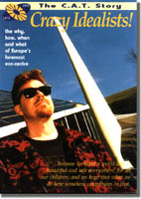
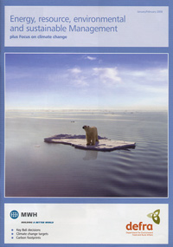
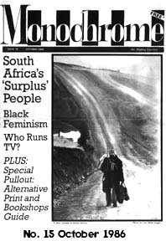
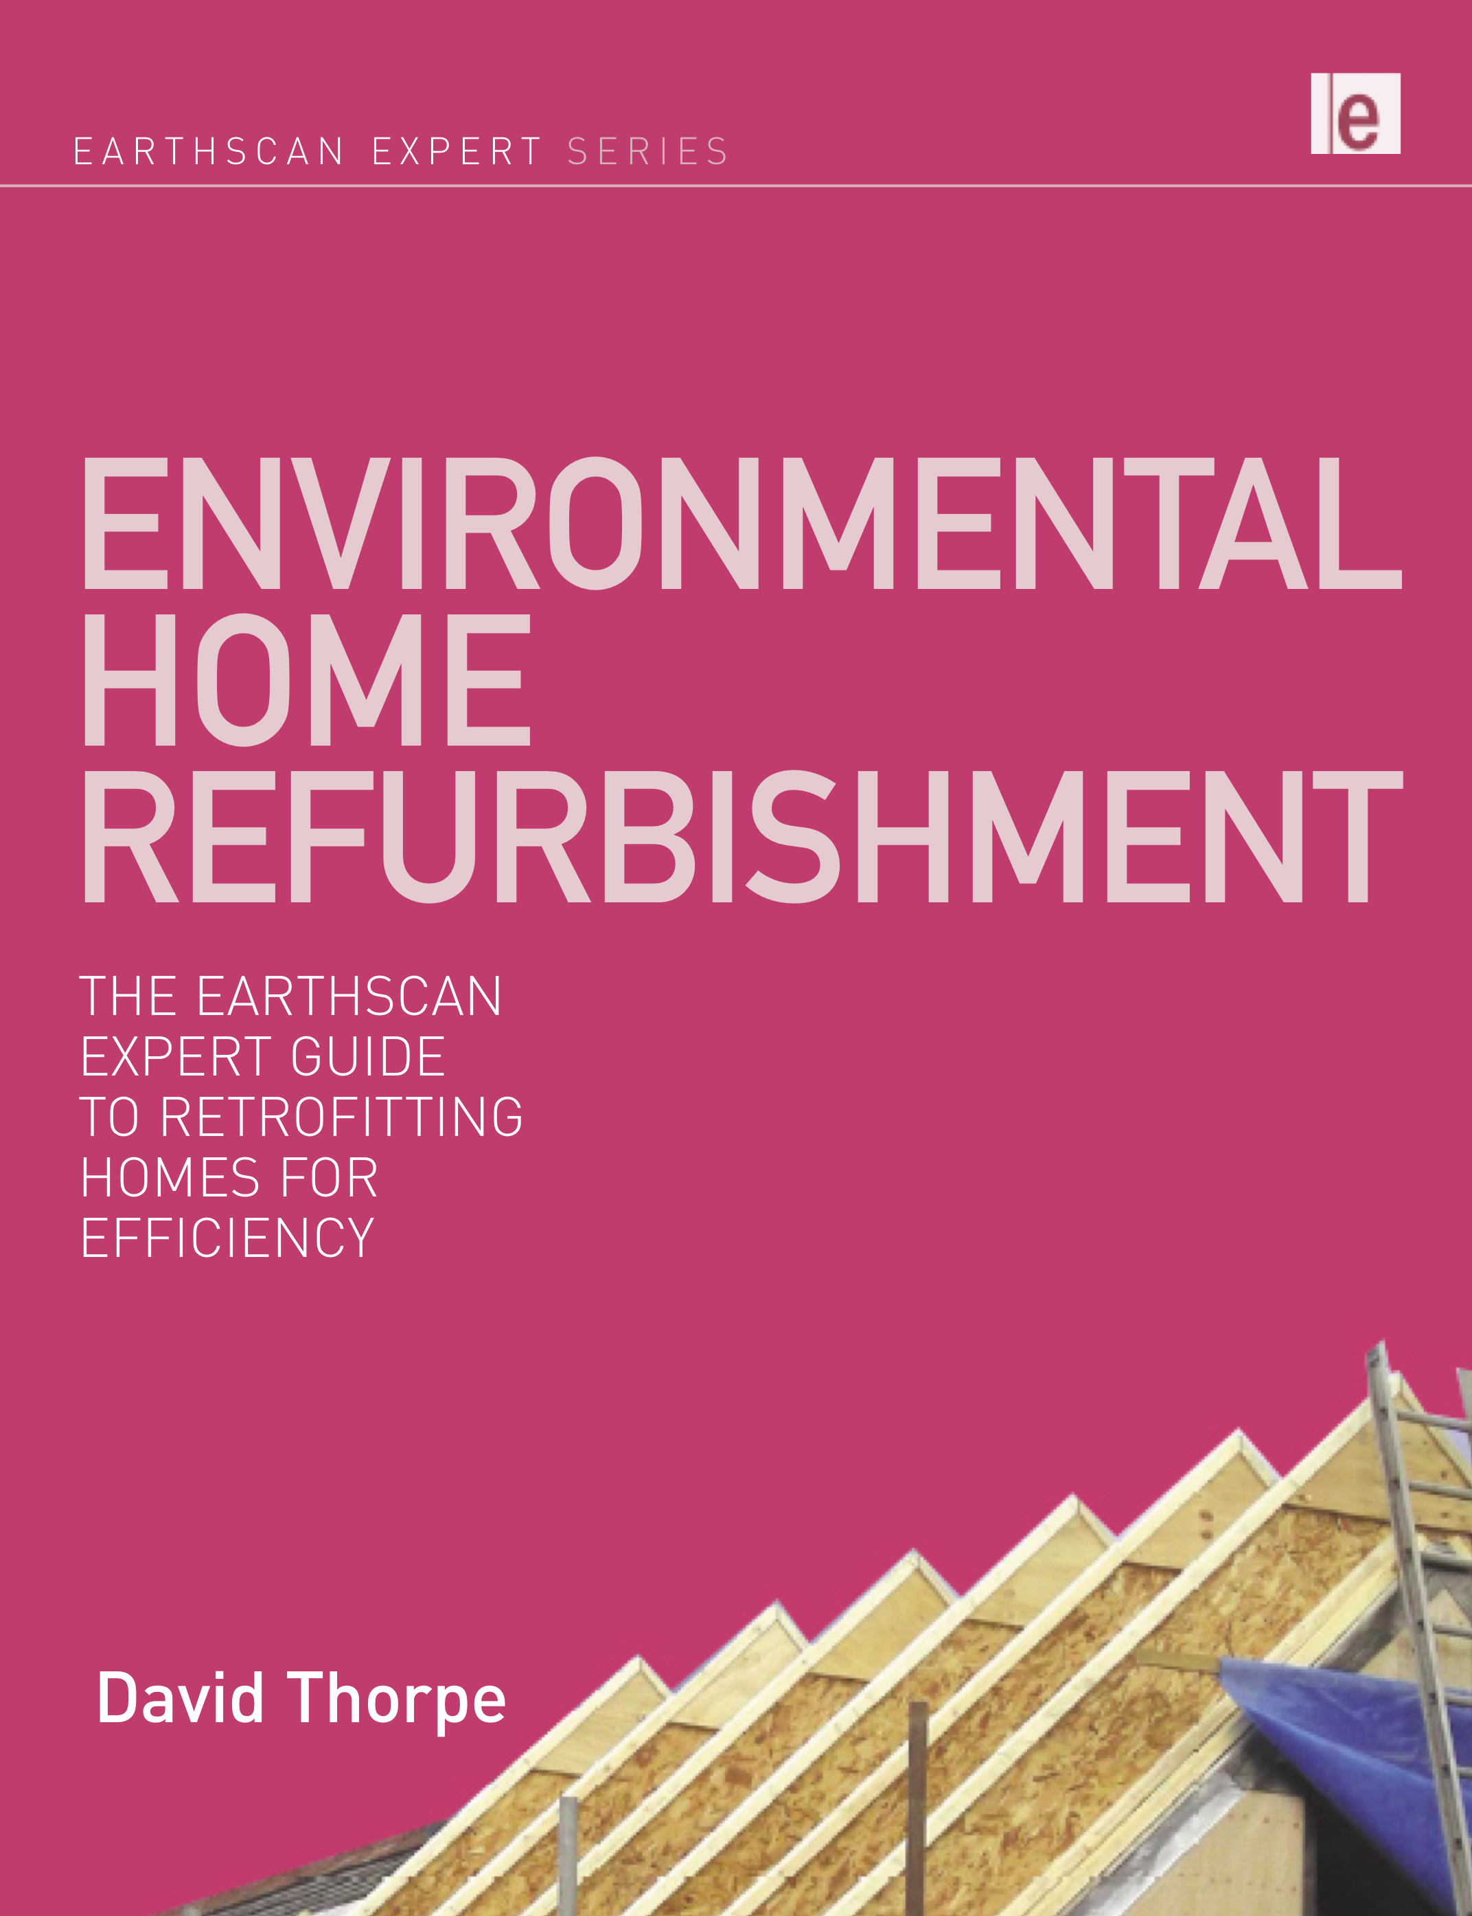
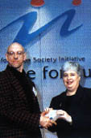
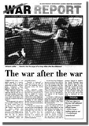
My work as an sustainability writer & editor

Slide 3
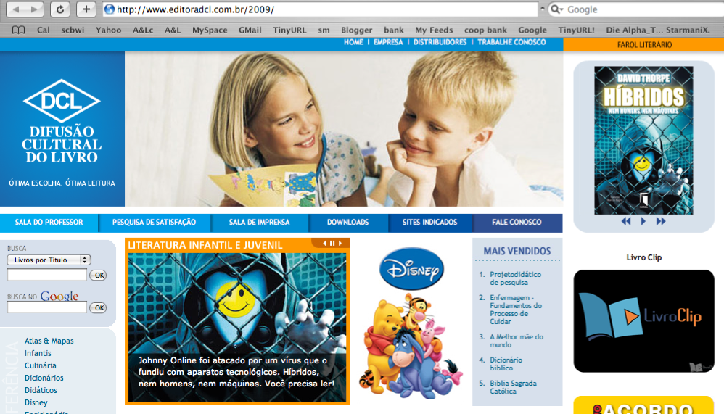
Hybridos - DCL

Slide 4
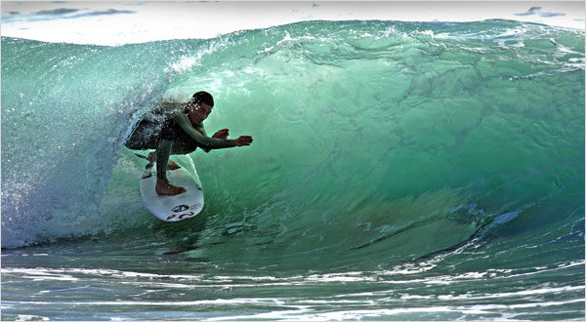
At the crossroads…
Boom or bust
Sustain or fail?
Exceed the limits, or live within our means?
Ride the new wave or sink beneath it?

Slide 5
Global warming
Number one challenge facing the world and Brazil
Latest science predicts 4 degrees warming this century if business as usual
This means the Amazon will be a desert if we do nothing
Read Mark Lynas’ book ‘Six Degrees’
Clearly ‘business as usual’ must end

Slide 6
Not enough earths!
The Ecological Footprint (EF) is a measure of the consumption of renewable natural resources by a human population. A country's EF is the total area of productive land or sea required to produce all the crops, meat, seafood, wood and fibre it consumes, to sustain its energy consumption and to give space for its infrastructure.

Slide 7
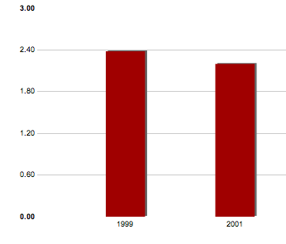
Brazil’s footprint
31st in the world (and rising)
Two earths (but depends where you live and how rich you are)
5th in ranking of greenhouse gas emissions

Slide 8
Learn from others
Businesses in developing countries like Brazil can leapfrog over the mistakes made by those in developed countries.
Become leaders in the new business models and new business areas

Slide 9
What is sustainable development?
A stool with three legs:
Environmental
Social
Economic

Slide 10
Businesses will be sustainable or not exist. But what are the choices?
Companies can embrace sustainable models of doing business whatever kind of business they are in and be part of the solution rather than a problem; or
Companies can actively exploit the new business opportunities presented by the requirements of building a more sustainable world.

Slide 11
Sustainable models
Prosperity without growth
Jackson says: "There is no case to abandon growth universally. But there is a strong case for the developed nations to make room for growth in poorer countries. It is in these poorer countries that growth really does make a difference. In richer countries the returns on further growth appear much more limited; for example subjective well-being diminishes rapidly at higher income levels."

Slide 12
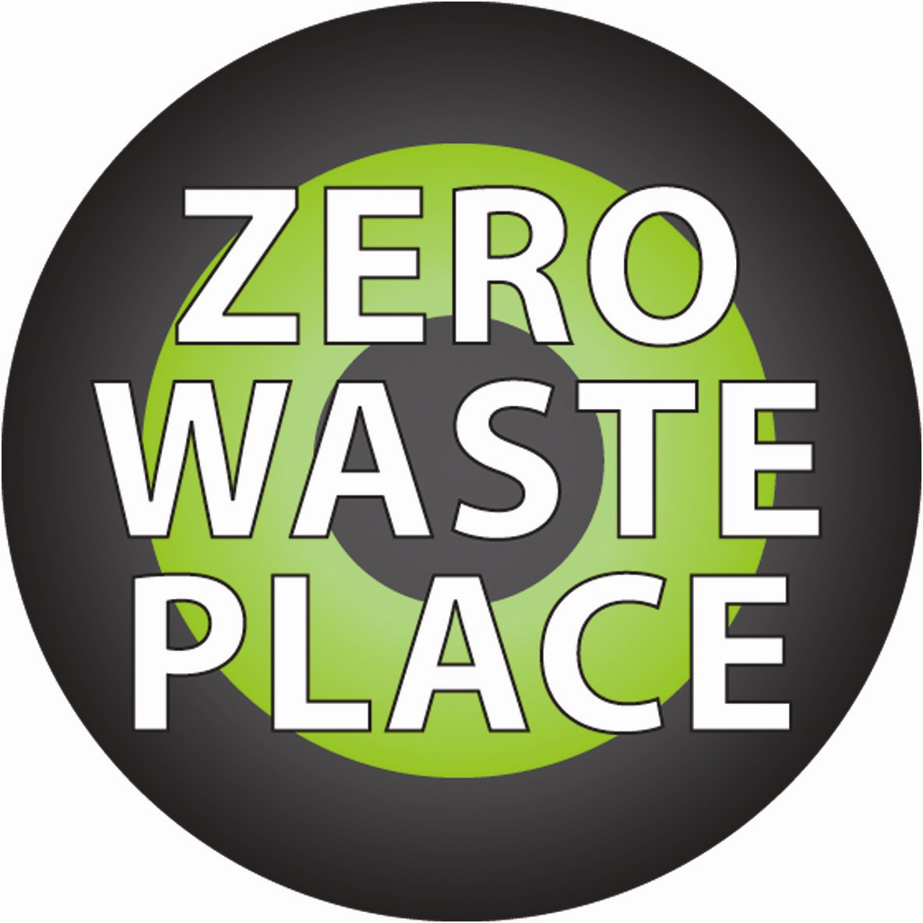
The secret…
The developed world and rich countries have got it wrong
Don’t copy them
It’s easier to get a habit than give one up
So don’t get the bad habits in the first place!

Slide 13
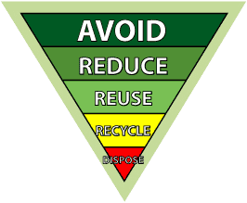
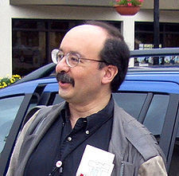
Eco-minimalism
Reduce
Re-use
Repair
Recycle
Renew
Do more with less:
“Resource efficiency”
Halving resource use doubles wealth
Amory
Lovins

Slide 14
The triple bottom line
"TBL" or
"3BL” or
"people, planet, profit" or
"the three pillars”
Social
Economic
Environmental
Means a commitment to corporate social responsibility
Inspires stakeholder confidence
Reported in annual reports

Slide 15
Closed loops

Slide 16
Virtuous cycles
Supply line commitments
Customer commitments
Double benefit – locks in wealth in the good new sector
Starves old sector of funds – don’t reward bad behaviour!

Slide 17
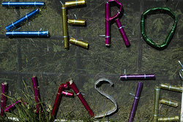
Industrial symbiosis
In nature there is no waste
One person’s waste is another’s feedstock

Slide 18
Examples
www.nisp.org.uk
www.wrap.co.uk
http://freecycle.org/group/Brazil/Brazil/Sao%20Paulo
Create new markets for products made from recycled materials
Implies the use of standards: there are 139 on http://www.iso.org
Standards and labels give your customers confidence.

Slide 19
Exploiting the new markets
Low or zero carbon products and services:
Solar water heating
Heat pumps
Plugs for sinks
Shutters for windows
Fuel cells
Solar electricity
Energy audits
Energy service companies (ESCOs)
Energy-saving ICT
No-carbon air conditioning (e.g. phase change materials)
Zero or low carbon homes
Bio-char (4 x win)
Eco-schools

Slide 20
New thinking ideas and examples
George Soros with Nobel laureate economists has launched the Institute for New Economic Thought
www.sustainablebusiness.com
World Business Council for Sustainable Development (WBCSD): www.wbcsd.org
The New Economics Foundation: www.neweconomics.org

Slide 21
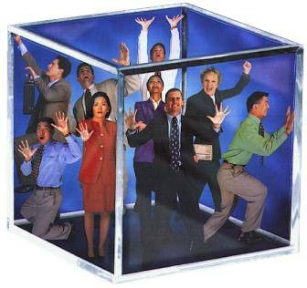
Be part of the solution!
Think outside the box!
Imagine a better world for the whole of nature!
Work for happier and more prosperous citizens!
It’s not about money but quality of life! – fulfilment!
If you’re not part of the solution, you’re part of the problem!

Slide 22
Thank you! Obrigado! www.davidthorpe.info

